Slide 1
Southern Water Corp.
Executive Presentation

Slide 2
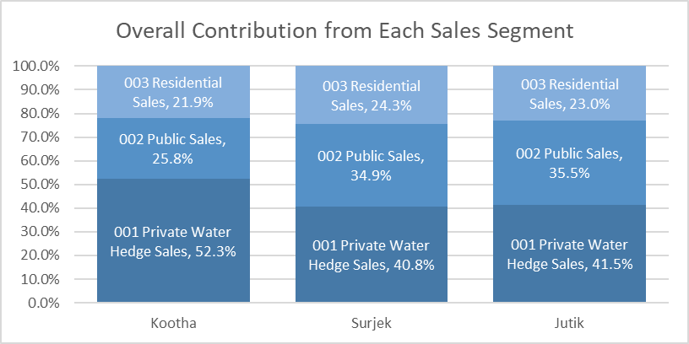
Segmentation of the revenues by unit, reveals that of the three (3) customer segments, Private Water Hedge Sales ($187.42 M) are the most popular, followed by Public Sales ($146.93 M) and lastly Residential Sales ($102.51 M)

Slide 3
Of the $436.87 M in Revenue Sales over the July-2013 to June-2014 Period, Surjek provides close to 50% of Sales Volumes ($202.26 M), with Jutik ($ 163.67 M) and Kootha ($70.94 M) providing the remaining.

Slide 4
Targeted Expense Analysis reveals an interesting trend; Overall Costs sharply increase from December, with Surjek contributing $$179.32M (56%) towards the overall cost-base.

Slide 5
Further analysis singles-out Surjek with 179.32M (56%) worth of expenses, contrasted to a much lower spend from Kootha ($51M) and Jutik ($90.72M), largely due to lower Chemical and Labour Expenditure.

Slide 6
Drilling-down to the cost-element level, reveals an indicative relationship between water production and chemical expenditure with this being particularly pronounced for the _____ Unit which coincidentally has the highest rate of water production.

Slide 7
Concluding our analysis, Jutik has the highest overall EBIT contributions ($$72.94 M), followed by Surjek ($22.94M) , and lastly Kootha ($19.72M). However, from an EBIT Margin (%) perspective, Kootha has a higher margin than that of Surjek, indicative of a lower revenue-to-expense ratio.¹
Note:¹ We can clearly see for Surjek over the October, November and May Periods – expenses were far higher than revenues which contributed to this lower revenue-to-expense ratio.
Notes:
We’re now at the final slide for our story. We’ve shown the revenues, we’ve unpacked the expenditures and now, finally, we’re going to close out the analysis by showing the overall EBIT for each unit. In this Slide, we want to convey to the audience which Unit(s) bring in the most EBIT from both a EBIT ($) perspective as well as highlighting the EBIT Margin – Do any units have lower revenues than another unit, but higher EBIT Margins, indicating they are most cost effective?
It’s time for us to close out this story below: A) Create two charts which highlight the overall EBIT per Unit (i.e. Kootha, Surjek and Jutik), as well as a second chart which shows the EBIT Trends for each Unit on a monthly basis (June-13 to June-14).
Hint: The Chart you’ve created for the Expenses Tab, Q9, may be helpful.

